Slide 1
Experiments or Lab Programs:
Implement and demonstrate the FIND-S algorithm for finding the most specific hypothesis based on a given set of training data samples. Read the training data from a .CSV file.
For a given set of training data examples stored in a .CSV file, implement and demonstrate the Candidate Elimination algorithm to output a description of the set of all hypotheses consistent with the training examples.
Write a program to demonstrate the working of the decision tree based ID3 algorithm. Use an appropriate data set for building the decision tree and apply this knowledge to classify a new sample.
Write a program to implement the naïve Bayesian classifier for a sample training data set stored as a .CSV file. Compute the accuracy of the classifier, considering few test data sets.
Write a program to implement k-Nearest Neighbour algorithm to classify the iris data set. Print both correct and wrong predictions.
Build an Artificial Neural Network by implementing the Backpropagation algorithm and test the same using appropriate data sets.
Write a program to demonstrate Regression analysis with residual plots on a given data set.
Write a program to compute summary statistics such as mean, median, mode, standard deviation and variance of the given different types of data.
Write a program to implement k-Means clustering algorithm to cluster the set of data stored in .CSV file.

Slide 2
Program-1: Implement and demonstrate the FIND-S algorithm for finding the most specific hypothesis based on a given set of training data samples. Read the training data from a .CSV file.

Slide 3
FIND-S algorithm: (Find-Yes)
FIND-S (Find-Specific) is a simple concept learning algorithm used in Machine Learning. It finds the most specific hypothesis that fits all the positive training examples in the dataset.

Slide 4
✅ What is Concept Learning?
Concept Learning is a type of supervised learning where the goal is to learn a rule or function (called a concept) that classifies examples into positive (Yes) or negative (No) classes.
For example:
Suppose you're trying to learn the concept of "EnjoySport".
You are given a dataset with different weather conditions.
Each row in the data says whether the sport was enjoyed (Yes) or not (No) under those conditions.
Your job is to learn what combination of conditions leads to "EnjoySport = Yes" — this is the "concept".

Slide 5
✅ Hypothesis in Machine Learning? (Theory or Thesis)
A hypothesis is a candidate rule or guess that might describe the concept you're trying to learn.
A hypothesis is a guess or rule that helps predict the output (like Yes/No) given an input.
For example:
Hypothesis= ['Sunny', 'Warm', '?', 'Strong', '?', ‘?’]
This hypothesis says:
"A person will enjoy sport if it is Sunny and Warm and Wind is Strong (rest can be anything)."
This means:
"If the sky is Sunny, and the temperature is Warm, and the wind is Strong — regardless of other factors — then we can say YES to 'EnjoySport'".

Slide 6
🎯 Purpose of FIND-S
Learn from positive examples only (i.e., where the target output is Yes).
Ignore negative examples (No).
Construct the most specific hypothesis that explains all the positive instances.

Slide 7
🧠 How FIND-S Works (Step-by-Step)
Let’s say each example has n attributes, and the goal is to find a hypothesis ‘h’ that is as specific as possible, but consistent with all positive examples.
Step 1: Initialize
Start with the most specific hypothesis possible.
Example: ['∅', '∅', '∅'] or simply the first positive example. (Means the output is Positive)
Step 2: For each training example:
If the example is positive:
Compare it with the current hypothesis.
If any attribute in the hypothesis is different from the current example:
Replace that attribute with ? (which means "any value").
If the example is negative, ignore it.
Step 3: Continue until all examples are processed.
Step 4: The resulting hypothesis is the most specific generalization consistent with the positive examples.

Slide 8
Example Dataset:
Let’s say we’re learning the concept of EnjoySport. Our training dataset looks like this:
Sky | Temp | Humidity | Wind | Water | Forecast | EnjoySport
Sunny | Warm | Normal | Strong | Warm | Same | Yes
Sunny | Warm | High | Strong | Warm | Same | Yes
Rainy | Cold | High | Strong | Warm | Change | No
Sunny | Warm | High | Strong | Cool | Change | Yes

Slide 9
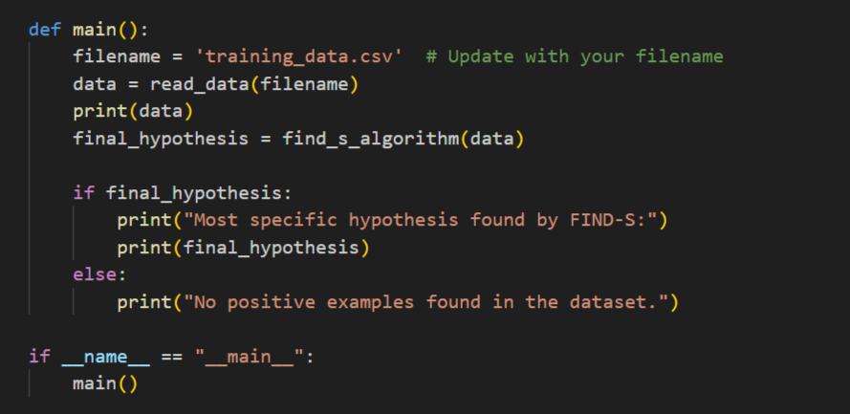

Slide 10
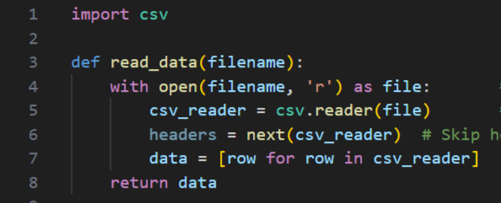

Slide 11
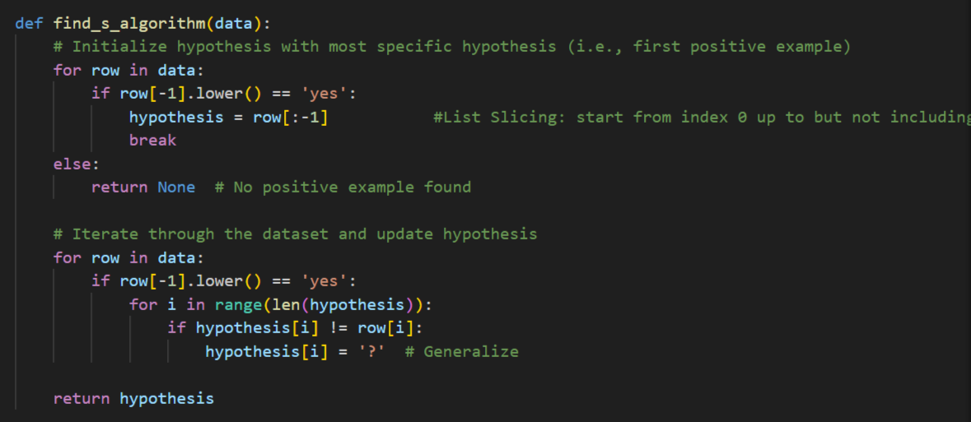

Slide 12
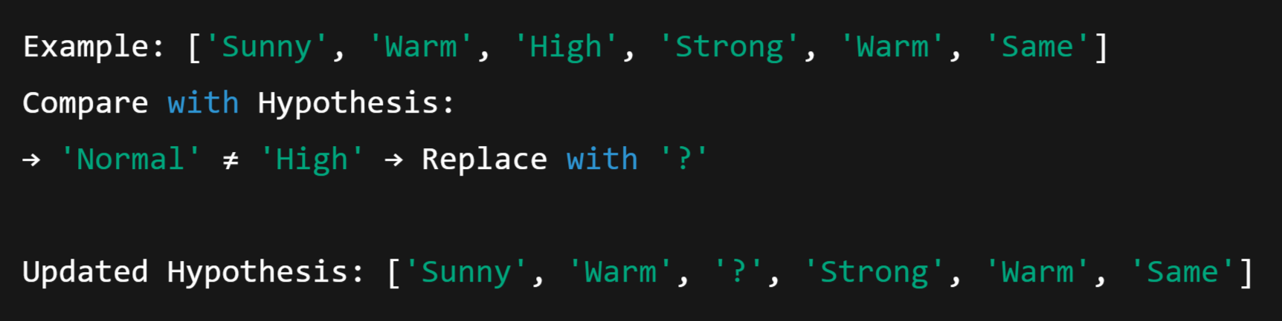
🚀 Step-by-Step Working of FIND-S on Above Data
Start with the first positive example:
Process second positive example:

Slide 13
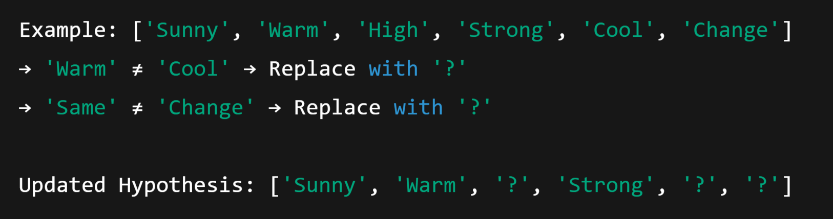
3. Skip third example (it's negative)
4. Process fourth positive example:

Slide 14

🧾 Final Hypothesis:
This means:
Sky must be Sunny
Temp must be Warm
Wind must be Strong
All other values can be anything

Slide 15
Program-2: For a given set of training data examples stored in a .CSV file, implement and demonstrate the Candidate Elimination algorithm to output a description of the set of all hypotheses consistent with the training examples.

Slide 16
🧠 What is the Candidate Elimination Algorithm?
The Candidate Elimination Algorithm is a supervised learning algorithm in Machine Learning that:
Learns the target concept from training data
Maintains a version space:
S: The most specific hypotheses (specific boundary)
G: The most general hypotheses (general boundary)
The version space is the set of all hypotheses consistent with the training data seen so far. The goal is to narrow this space as we process more examples.

Slide 17
📌 1. What is a Target Concept?
In machine learning, a target concept is the thing we are trying to learn or classify.
In our example
The column EnjoySport is the target concept. We are trying to learn a rule (hypothesis) that tells us under what conditions a person enjoys sport.
Sky | Temp | Humidity | Wind | Water | Forecast | EnjoySport
Sunny | Warm | Normal | Strong | Warm | Same | Yes

Slide 18
What is Version Space?
The version space is the set of all possible hypotheses that are consistent with the training examples seen so far.
It is represented as:
A boundary of S: Specific hypotheses
A boundary of G: General hypotheses

Slide 19
What is S (Specific Boundary)?
S stands for the most specific hypothesis that fits all positive examples.
It starts as the most specific possible: ['∅', '∅', ..., '∅'] (rejects everything).
It gets generalized when we see positive examples.
Example:
After seeing positive examples:
This means: "Enjoy sport only under these specific conditions."

Slide 20
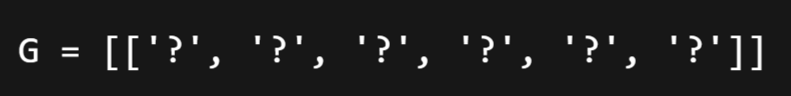
📌 5. What is G (General Boundary)?
G is the set of most general hypotheses that do not contradict any negative example.
It starts as:
(Accepts everything)
It gets specialized (made stricter) when we see negative examples.

Slide 21
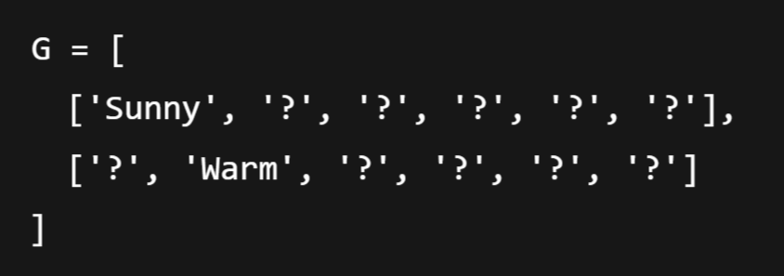
Example:
After processing some negative examples:
This means: "Do NOT enjoy sport when it’s not Sunny or not Warm."

Slide 22
📌 Key Idea
We maintain two boundaries:
S: Starts from the most specific hypothesis — '∅' (doesn’t accept anything)
G: Starts from the most general hypothesis — '?' for all attributes (accepts everything)
With each training example:
If it's positive:
Generalize S minimally to include the example.
Remove G hypotheses that do not include the example.
If it's negative:
Specialize G minimally to exclude the example.
Remove S hypotheses that include the negative example.

Slide 23
🧾 Example
Let’s say we’re learning the concept of EnjoySport. Our training dataset looks like this:
Sky | Temp | Humidity | Wind | Water | Forecast | EnjoySport
Sunny | Warm | Normal | Strong | Warm | Same | Yes
Sunny | Warm | High | Strong | Warm | Same | Yes
Rainy | Cold | High | Strong | Warm | Change | No
Sunny | Warm | High | Strong | Cool | Change | Yes

Slide 24
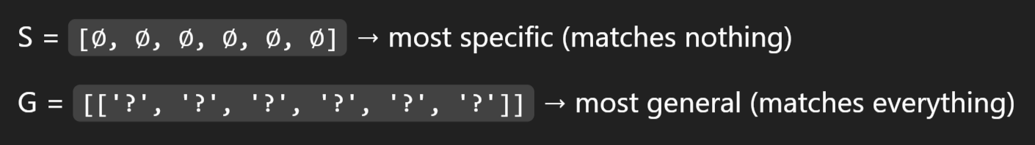
Step-by-step Execution
Initial state:
After Example 1: Positive:
S becomes this example:
G remains unchanged.

Slide 25
3. After Example 2: Positive:
S is generalized: "Normal" ≠ "High" → replace with ‘?’
G remains the same.

Slide 26
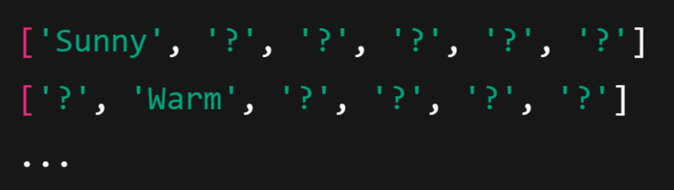
4. After Example 3: Negative:
This negative example is covered by G and must be excluded.
Specialize G (i.e., make it more specific to exclude this row but still include S):
We generate specific hypotheses like:
All combinations that do not match the negative example but are consistent with S.

Slide 27
5. After Example 4: Positive:
S is generalized again:
Water: "Warm" ≠ "Cool" → '?'
Forecast: "Same" ≠ "Change" → ‘?’
G: remove hypotheses that don't cover this positive example.

Slide 28
✅ Final Hypotheses
S = ['Sunny', 'Warm', '?', 'Strong', '?', '?']
G = a set of hypotheses that include all positive and exclude all negative examples

Slide 29
5. Write a program to implement k-Nearest Neighbour algorithm to classify the iris data set. Print both correct and wrong predictions.

Slide 30
🌸 What is the Iris Dataset?
The Iris dataset is one of the most famous datasets in machine learning and statistics. It was introduced by the British biologist Ronald A. Fisher in 1936 and is often used to demonstrate classification algorithms.
🧠 What Does It Contain?
The dataset contains 150 samples of iris flowers, divided into 3 species (classes):
Species (Class) | Label (Target)
Iris Setosa | 0
Iris Versicolor | 1
Iris Virginica | 2

Slide 31
Each flower is described by 4 numeric features:
Feature | Description | Unit
Sepal length | Length of the sepal (outer leaf) | cm
Sepal width | Width of the sepal | cm
Petal length | Length of the petal (inner leaf) | cm
Petal width | Width of the petal | cm

Slide 32
📊 Sample Data:
Note: Each row represents one flower.
Sepal Length | Sepal Width | Petal Length | Petal Width | Species
5.1 | 3.5 | 1.4 | 0.2 | Iris-setosa
7.0 | 3.2 | 4.7 | 1.4 | Iris-versicolor
6.3 | 3.3 | 6.0 | 2.5 | Iris-virginica

Slide 33
🧪 Why Is It So Popular?
Small size – only 150 rows.
Clean and well-balanced – 50 samples per class.
Simple structure – only 4 input features.
Great for learning classification, visualization, and data processing techniques.

Slide 34
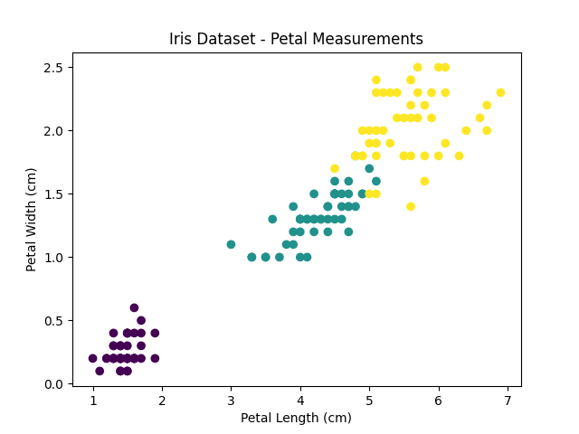
📈 Visualization:
The below visualization shows how well classes are separated in iris dataset:

Slide 35
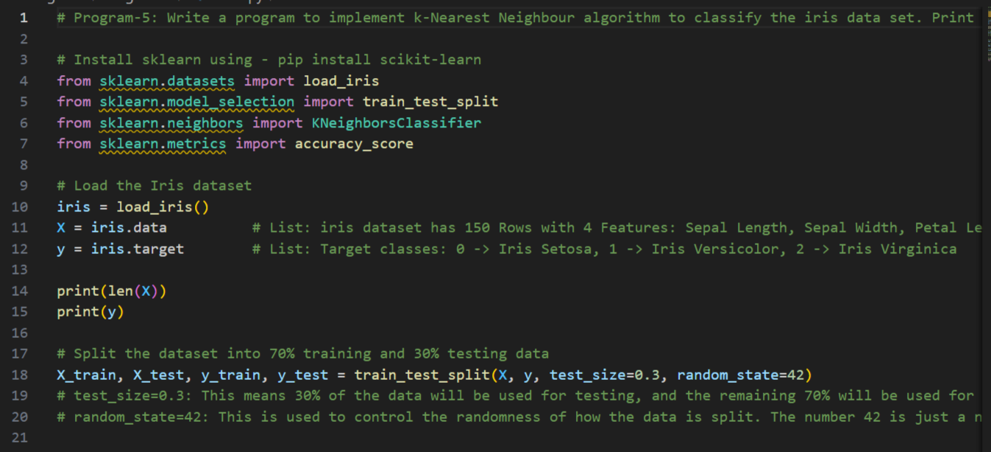

Slide 36
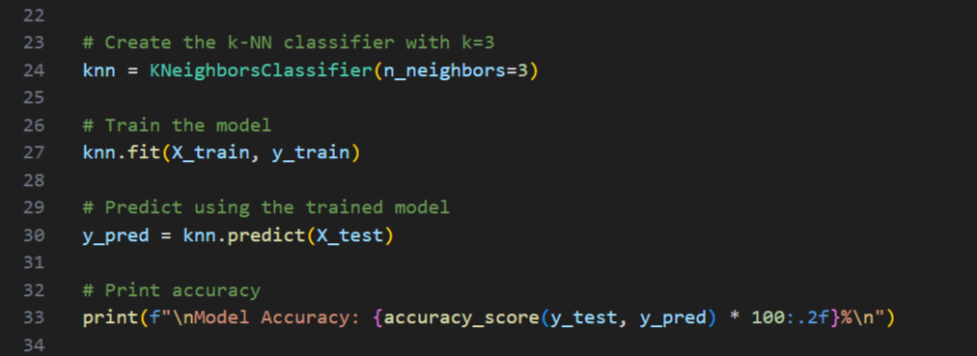

Slide 37
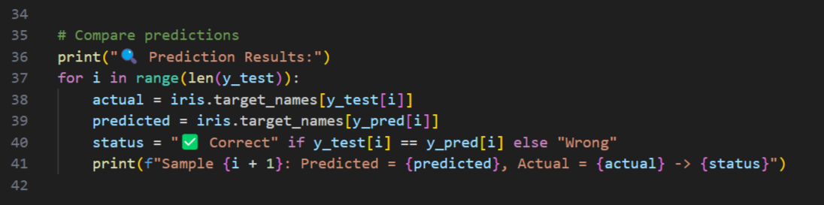

Slide 38
3. Write a program to demonstrate the working of the decision tree based ID3 algorithm. Use an appropriate data set for building the decision tree and apply this knowledge to classify a new sample.

Slide 39
🧠 What is ID3?
ID3 (Iterative Dichotomiser 3) is a popular decision tree algorithm used in machine learning for classification tasks.
Dichotomiser means :to divide into two parts, classes, or groups
🔍 Core Idea of ID3
ID3 builds a decision tree by selecting the attribute that gives the maximum information gain at each node.
It uses:
Entropy → Measures the impurity (or disorder) in a dataset
Information Gain → How much entropy is reduced by splitting on an attribute
Note: Impurity means how mixed or disordered a group of data is with respect to its target labels (like "Yes" or "No").

Slide 40
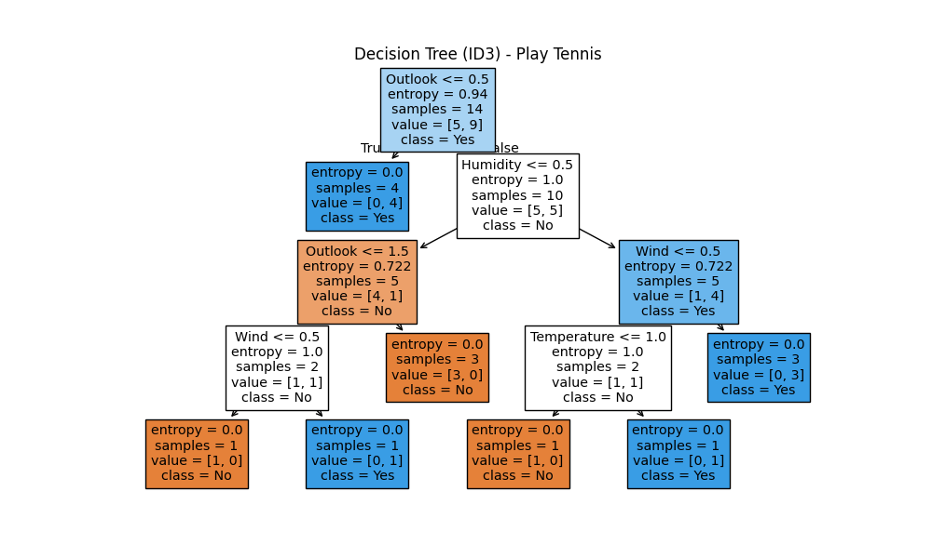

Slide 41
📘 How to Read the Tree:
Each box in the tree is a decision node or leaf. It contains:
A condition to test (e.g., Outlook <= 0.5) -> It tells Should I go left or right? Like Conditional Statement.
Entropy → how impure (Mixed values) this node is (0 means pure)
Samples → how many records reached this node
Value = [No, Yes] → count of class labels at this node
Class → predicted class at this node (No or Yes)

